Slide 1
Implementing Propensity Score Methods in R: MatchIt and Twang
Lab 3

Slide 2
Overview
Why do we use propensity scores again?
ATE vs ATT causal estimands
Propensity score matching in MatchIt
Overview of propensity score weighting
Propensity score weighting in Twang
Propensity score weighting via logistic regression

Slide 3
Propensity score methods
Goal = adjust for potential selection bias / confounding that arises due to baseline differences between treatment groups
Important caveat: propensity scores can only address measured confounders
Assumption of “unconfounded treatment assignment”, “ignorable treatment assignment”, “no hidden bias”
Several methods: propensity score matching, weighting, or subclassification

Slide 4
Advantages of propensity score methods over standard covariate adjustment
Regression adjustment relies heavily on correct specification of model (note: this approach is more efficient than PS when model is exactly correctly specified….but this is rare!)
Avoids issue of extrapolation beyond observed data, which may bias results (Ho, Imai, King & Stuart, 2007)
Covariate adjustment uses data on treated and control subjects without regard to their comparability – relies on the model to predict how subjects would have responded under treatments they did not receive
Provide dimension reduction, which may be advantageous with many covariates
Philosophically cleaner to separate controlling for confounding from structural model of interest (Rubin)

Slide 5
Causal effects of interest
Average Treatment Effect (ATE) = compares mean outcome if entire population had received Treatment to mean outcome if entire population had received Control
Meaningful effect estimate when there is the potential to disseminate treatment to entire population
Average Treatment Effect on the Treated (ATT) = compares mean outcomes for individuals who in reality received Treatment to the mean outcomes if these same individuals had instead received Control
Of interest when only a subset of entire population typically receives the treatment

Slide 6
When can I calculate the ATT & ATE?
1:1 matching or k:1 matching can only calculate ATT
By design, choosing controls that match the treated
Full matching, subclassification, and weighting methods can calculate ATT or ATE
Inverse Probability of Treatment Weights (IPTW) =ATE weights
“Weighting by the odds” = ATT weights

Slide 7
Propensity score analysis in MatchIt
Matching
Subclassification

Slide 8
Basic matching command
m.out <- matchit(treat ~ age + educ + black + hispan + married + re74 + re75, data = lalonde, method = ”nearest")
Method options
"nearest" (nearest neighbor matching) -- DEFAULT
"exact" (exact matching)
"full" (full matching)
"genetic" (genetic matching)
"optimal" (optimal matching)
"subclass" (subclassification)

Slide 9
Other options when matching
Nearest Neighbor Matching
Default is 1:1 matching – can increase number of controls matched to each treated individual
method = “nearest”; ratio = k
Can specify exact matching on variables
exact = c(“var1”, “var2”)
Can specify Mahalanobis matching
mahvars=c(”var1", ”var2")
Can specify calipers
calipers = 0.10

Slide 10
Checking covariate balance after matching
Dual characteristics of PS score
PS predict treatment assignment
PS balances covariates
Important to assess how well propensity scores have achieved covariate balance before proceeding to final analysis
Theory says correctly estimated PS should balance covariates. Checking covariate balance is also a check on the PS model – if PS balance is good then implies PS model fit is adequate

Slide 11
Balance diagnostics in MatchIt
Balance table
print(summary(m.out,standardize=T))
Standardized Bias Plots
plot(summary(m.out,standardize=T), interactive=F)
Want standardized biases to be <0.20 after matching
PS jitter plot
plot(m.out, type = "jitter", interactive = F)
PS histogram plot
plot(m.out, type = "hist")
Want to see sufficient overlap between PS for individuals in treated and control groups

Slide 12
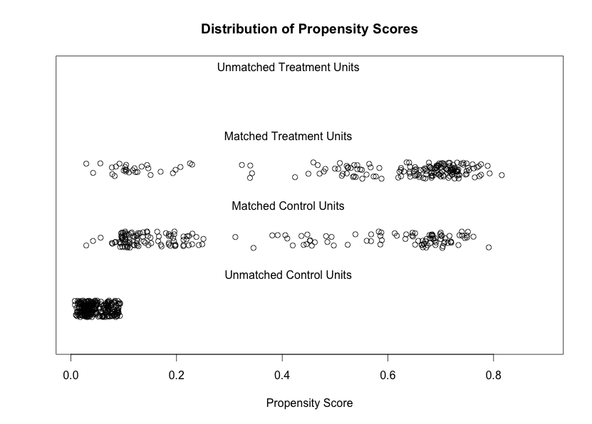
Propensity score dist by treatment group

Slide 13
Final Analysis Models with Matching
If covariate balance looks good, proceed to final analysis…
m.data = match.data(m.out)
# Only Treatment
model1 <- lm(re78 ~ treat,data=m.data)
summary(model1)
# Doubly Robust Approach (*Preferred*)
model2 <- lm(re78 ~ treat + age + educ + black + hispan + married + nodegree + re74 + re75, data=m.data)
summary(model2)

Slide 14
Subclassification overview
Can estimate ATT or ATE
Stratify individuals into “subclasses” of propensity scores (typically 5 – 10 classes)
Estimate treatment effect (final outcome model) within each subclass; final estimate is averaged over all subclasses
Formula for combining subclass estimates depends on ATT or ATE

Slide 15
Subclassification via MatchIt
# Subclassification
m.out.subclass <- matchit(treat ~ age + educ + black + hispan + married + re74 + re75, data = lalonde, method = "subclass")
Default is 6 subclasses, option is subclass = 10
# Assess balance table
print(summary(m.out.subclass,standardize=T))

Slide 16
Generate final treatment effect estimates
# Get matched data, with subclass indicators
data.subcl <- match.data(m.out.subclass)
# define N = total number of people in data
N <- dim(data.subcl)[1]
# Create vectors to hold the subclass specific effects(“effects”) and variances(“vars”) and the number of people in each subclass (“N.s”)
effects <- rep(NA, max(data.subcl$subclass))
vars <- rep(NA, max(data.subcl$subclass))
N.s <- rep(NA, max(data.subcl$subclass))
# Run regression model within each subclass
for(s in 1:max(data.subcl$subclass)){
tmp <- lm(re78 ~ treat + age + educ + black + hispan + married + re74 + re75, data=data.subcl, subset=subclass==s)
effects[s] <- tmp$coef[2]
vars[s] <- summary(tmp)$coef[2,2]^2
N.s[s] <- sum(data.subcl$subclass==s) }

Slide 17
Generate final treatment effect estimates
# Calculate overall effects, averaging across subclasses
effect <- sum((N.s/N)*effects)
stderror <- sqrt(sum((N.s/N)^2*vars))
print("Subclass specific effects and variances")
print(effects)
print(vars)
print("Overall effect and standard error")
print(effect)
print(stderror)

Slide 18
Propensity Score Weighting
ATE versus ATE weighting
Estimating PS weights with twang
Estimating PS weightings with logistic regression

Slide 19
ATE vs ATT weighting
ATE weights
ATT weights
Notes:
Example: what is the causal effect of a new childhood vaccination [that would be recommended for all children]

Slide 20
Example of ATE weighting
Observed Data:
Goal = want both groups to reflect total population
10 Males, 12 Females
Treatment | Control
8 Males | 2 Males
4 Females | 8 Females
 | Propensity Score | ATE Weight
TREATMENT | Pr(T=1 | Male) = 0.8 | 1 / 0.8 = 1.25
 | Pr(T=1 | Female) = 0.33 | 1 / 0.33 = 3
CONTROL | Pr(T=1 | Male) = 0.8 | 1 / (1-0.8) = 5
 | Pr(T=1 | Female) = 0.33 | 1 / (1-0.33) = 1.5

Slide 21
Example of ATE weighting
Observed Data:
Goal = want both groups to reflect total population
10 Males, 12 Females
Treatment | Control
8 Males | 2 Males
4 Females | 8 Females
 | Propensity Score | ATE Weight | Observed Population | Weighted Population
TREATMENT | Pr(T=1 | Male) = 0.8 | 1 / 0.8 = 1.25 | 8 | 10
 | Pr(T=1 | Female) = 0.33 | 1 / 0.33 = 3 | 4 | 12
CONTROL | Pr(T=1 | Male) = 0.8 | 1 / (1-0.8) = 5 | 2 | 10
 | Pr(T=1 | Female) = 0.33 | 1 / (1-0.33) = 1.5 | 8 | 12

Slide 22
Example of ATT weighting
Observed Data:
Goal = want Control group to look like Treatment group
8 Males, 4 Female
Treatment | Control
8 Males | 2 Males
4 Females | 8 Females
 | Propensity Score | ATT Weight
TREATMENT | Pr(T=1 | Male) = 0.8 | 1
 | Pr(T=1 | Female) = 0.33 | 1
CONTROL | Pr(T=1 | Male) = 0.8 | 0.8 / (1-0.8) = 4
 | Pr(T=1 | Female) = 0.33 | 0.33 / (1-0.33) = 0.5

Slide 23
Example of ATT weighting
Observed Data:
Goal = want Control group to look like Treatment group
8 Males, 4 Female
Treatment | Control
8 Males | 2 Males
4 Females | 8 Females
 | Propensity Score | ATT Weight | Observed Population | Weighted Population
TREATMENT | Pr(T=1 | Male) = 0.8 | 1 | 8 | 8
 | Pr(T=1 | Female) = 0.33 | 1 | 4 | 4
CONTROL | Pr(T=1 | Male) = 0.8 | 0.8 / (1-0.8) = 4 | 2 | 8
 | Pr(T=1 | Female) = 0.33 | 0.33 / (1-0.33) = 0.5 | 8 | 4

Slide 24
Overview of Twang package
twang = Toolkit for Weighting and Analysis of Nonequivalent Groups
In twang, propensity score modeling is done with a nonparametric model
Generalized Boosted Modeling
Very flexible & automated – assesses numerous models (with higher order / nonlinear terms) in order to find model that maximizes covariate balance

Slide 25
Estimating PS model in twang
#Get the same results each time!
set.seed(1234)
#Run PS model
ps.lalonde <- ps(treat ~ age + educ + black + hispan + nodegree + married + re74 + re75, data = lalonde, estimand = “ATT”, verbose=FALSE)

Slide 26
Effective sample size (ESS)
> summary(ps.lalonde)
n.treat n.ctrl ess.treat ess.ctrl max.es mean.es max.ks
unw 185 429 185 429.00000 1.7567745 0.56872589 0.64044604
ks.mean.ATT 185 429 185 22.50650 0.1364264 0.07042560 0.09989131
es.mean.ATT 185 429 185 21.57291 0.1422625 0.07004112 0.10242582
Effective sample size = estimate of number of control group individuals who are comparable to treatment group individuals
In ATT weighting ess.treat = n.treat
Ess.ctrl <= n.ctrl

Slide 27
Propensity score diagnostics
#Balance Table
bal.table(ps.lalonde)
Note that since by default twang is using 2 stopping rules (ks.stat.mean and es.stat.mean), there will be two versions of each of these plots
#Boxplot of Propensity Scores
plot(ps.lalonde, plots = "boxplot")
#Effect Size plots
plot(ps.lalonde, plots = "es“)

Slide 28
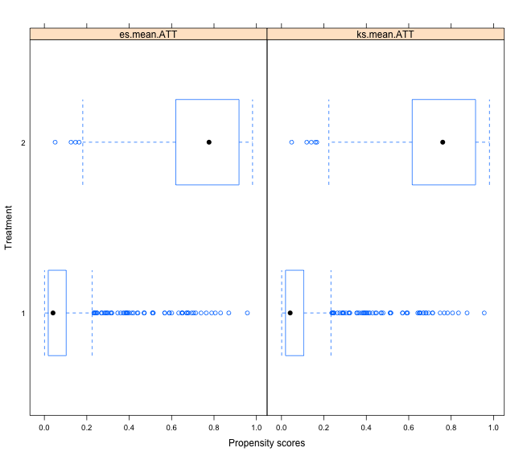
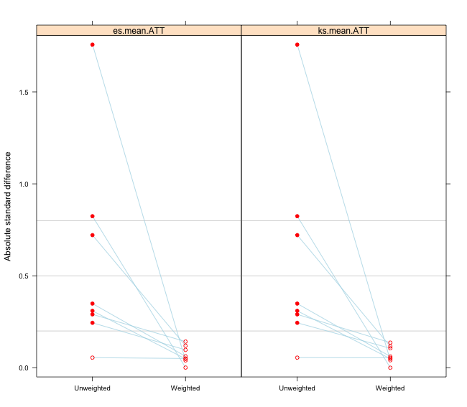
Plots
PS weighting will downweight individuals who are not similar (akin to dropping these individuals in matching). Excellent balance can still be achieved even when PS do not show a lot of overlap
Effect size plot show good balance after weighting

Slide 29
Extracting and examining weights
#Save weights
lalonde$w.att <- get.weights(ps.lalonde, stop.method="ks.mean")
or stop.method = “es.mean”
#Look at distribution of weights
summary(lalonde$w.att[lalonde$treat==1])
summary(lalonde$w.att[lalonde$treat==0])

Slide 30
Final outcome models
library(survey)
JUST TREATMENT VARIABLE
design.att <- svydesign(ids=~1,weights=~w.att, data=lalonde)
glm1 <- svyglm(re78 ~ treat,design=design.att)
summary(glm1)
DOUBLY ROBUST MODEL
glm2 <- svyglm(re78 ~ treat + age + educ + black + hispan + nodegree + married + re74 + re75, design=design.att)
summary(glm2)

Slide 31
Estimating PS with logistic regression
In practice, many people estimate propensity score via parametric logistic regression model
Should assess model fit and consider several different regression models (e.g. interaction terms, higher order terms)
Model fit is not as important as in traditional outcome analyses
Recall, good observed covariate balance indicates good model fit
Can generate your own balance tables and standardized bias plots

Slide 32
Modeling propensity scores in logistic regression model
ps.logit <- glm(treat ~ age + educ + black + hispan + nodegree + married + re74 + re75, data = lalonde, family = binomial)
summary(ps.logit)
# Get the propensity scores for each person
lalonde$pscores.logit <- predict(ps.logit,
type="response")
# Calculate the ATT weights
lalonde$w.logit.att <- ifelse(lalonde$treat==1, 1,lalonde$pscores.logit/(1-lalonde$pscores.logit))

Slide 33
Final outcome models
library(survey)
design.logit.att <- svydesign(ids=~1,
weights=~w.logit.att, data=lalonde)
DOUBLY ROBUST MODEL
glm2.logit <- svyglm(re78 ~ treat + age + educ + black + hispan + nodegree + married + re74 + re75, design=design.logit.att)
summary(glm2.logit)

Slide 34
Comparing approaches: doubly robust estimates
PS Matching
Coefficients:
Est SE t p-val
treat 1373.55763 791.03330 1.736 0.0833
Subclassification
Treat 1811.979 915.4138
PS Weighting (twang)
treat 4700 953.9 0.493 0.62237
PS Weighting (logistic)
treat 1237 786.3 1.574 0.1161

